Slide 1
RM Process IN
RC Community
May 24, 2022
Proprietary and Confidential

Slide 2
Contained within this standard work are instructions on:
How to Enter a Return Material Request using RC Community
How to Navigate to the RM Status and Attachment areas in RC Community
How to Look up your Invoice Number using RC Community
How to Look up your Invoice Number using COLTS
How to Clear Browser Cache

Slide 3
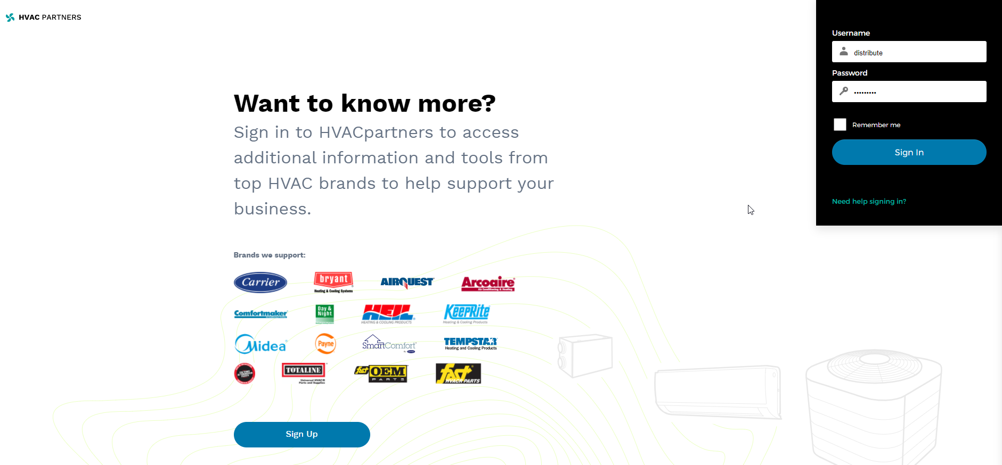
Login to the HVAC Partners Portal using the Link or hvacpartners.com

Slide 4
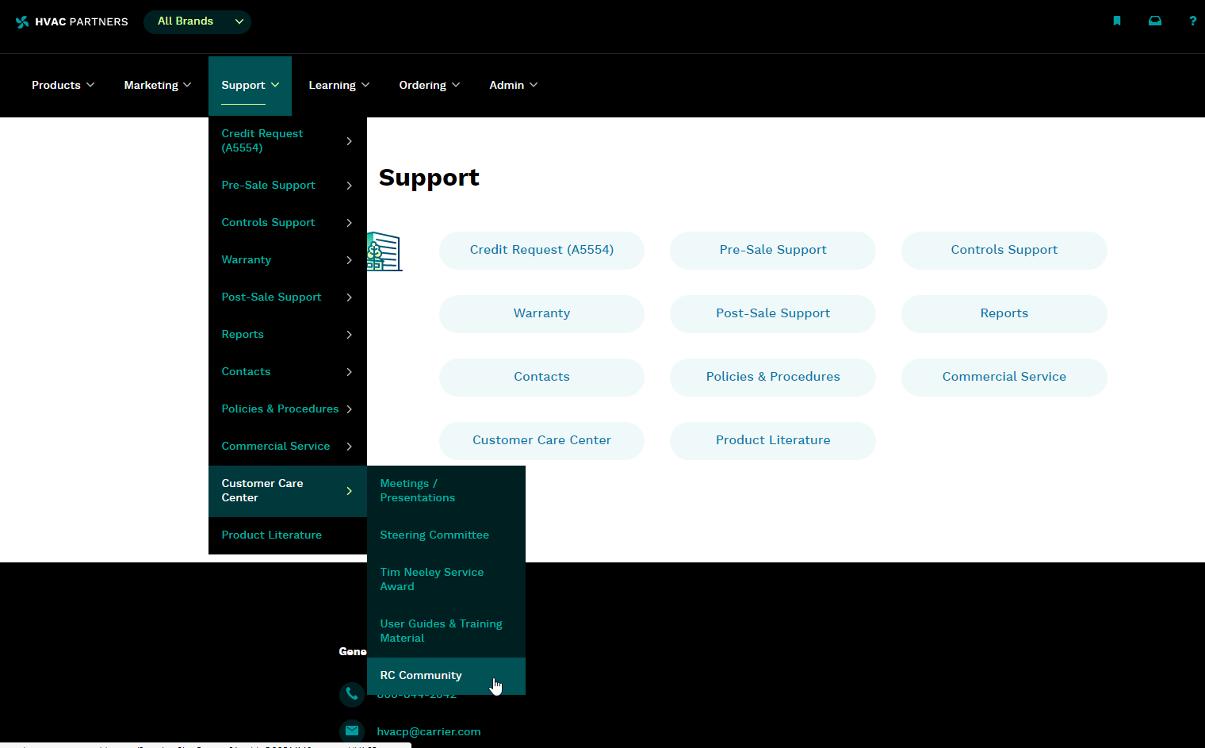
On the landing page of HVACPartners, navigate to “Support”, “Customer Care Center” and then “RC Community”

Slide 5
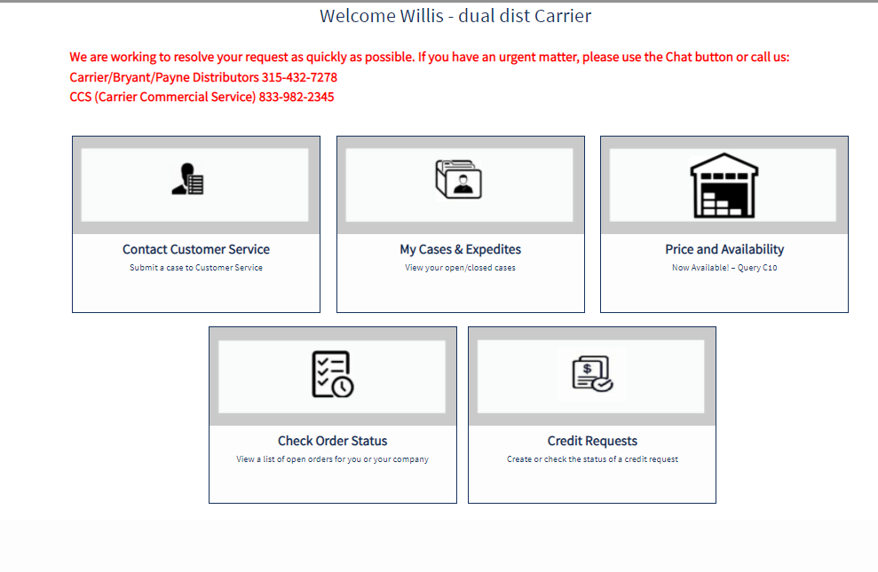
Once you have selected RC Community, the RC the landing page will appear. To proceed with the creation of a Return Material request, click on the “Contact Customer Service” tile

Slide 6
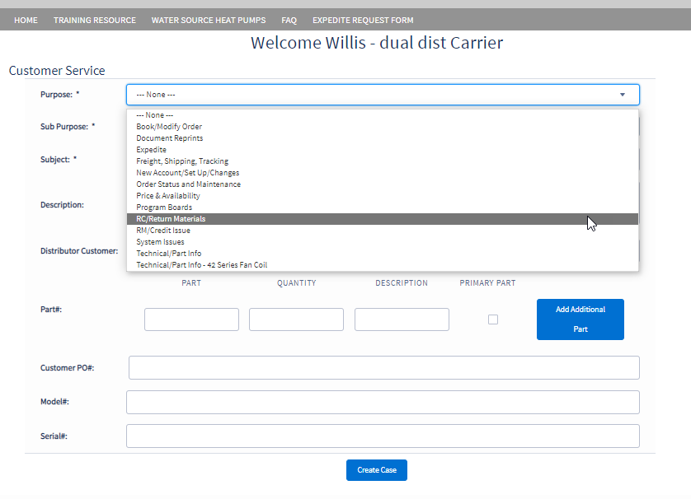
On this page, under the “Purpose” field select “RC/Return Materials”. This will change the form layout to the standard intake form for placing return requests

Slide 7
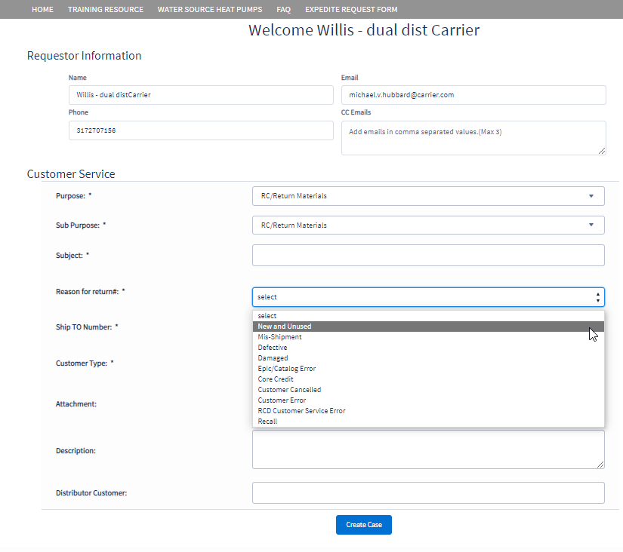
Fill in the subject line and select a Reason for Return. Once you have selected the reason, you will be prompted to enter in your PO, Invoice, and/or Part number.

Slide 8
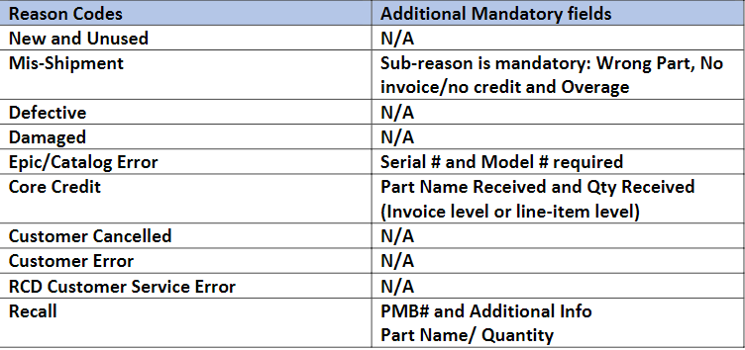
The list of reason codes and additional mandatory fields are as follows:
Please note: In the form, the fields marked with *(Asterisk) are mandatory for all reason codes

Slide 10
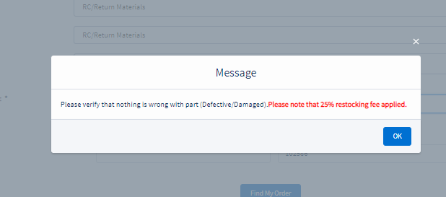
Depending on the reason you select, a message may pop up containing information about your return. Read message and select “OK” to proceed.

Slide 11
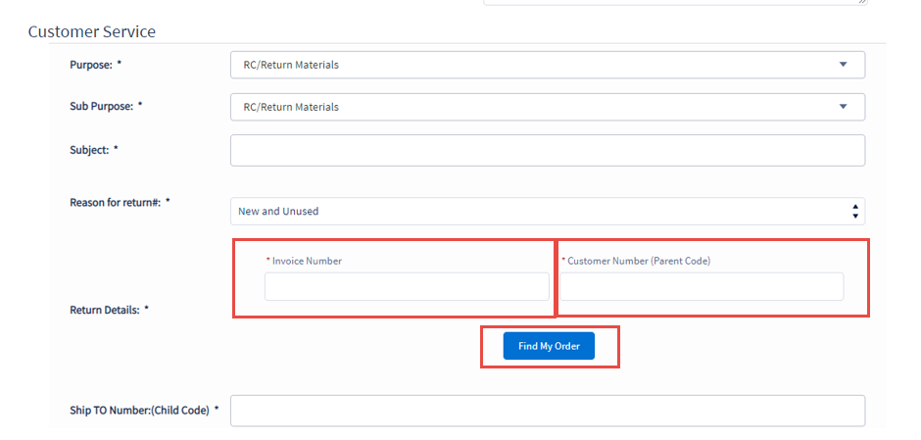
Based on the type of return request, fill in the remaining fields including the Customer Invoice number and Customer Number, then click on “Find my Order”. The form will auto fetch the details of the invoice from the backend. It will then present you with a list of items to choose from for a return request.
Please Note: The Customer Number needs to be verified for accuracy. It should be you C10 Parent Code.

Slide 12
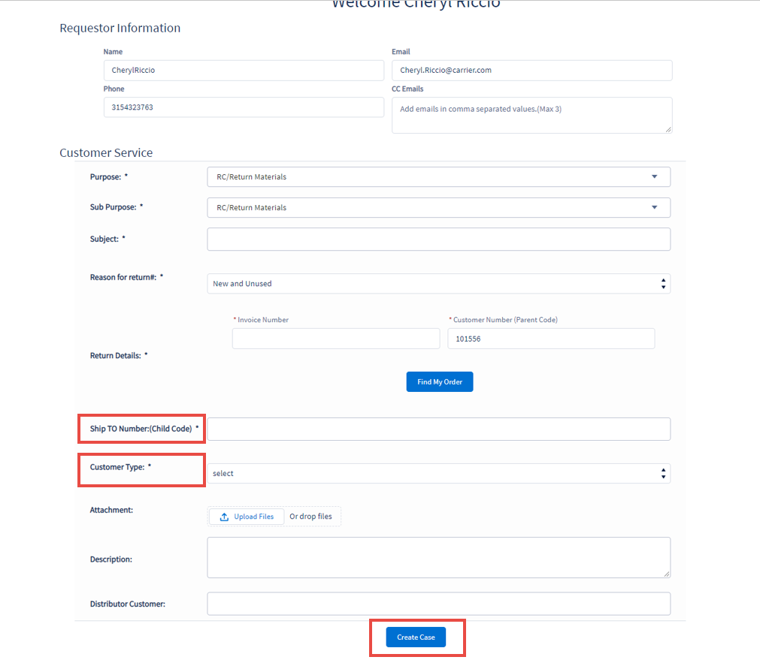
Fill up the details on the form as necessary, when finished click on Create Case
Please note your Ship To Number is your C10 Child Code

Slide 13
Pop-up notification once the case has been created with the case number:

Slide 14
Required Field Definitions

Slide 15
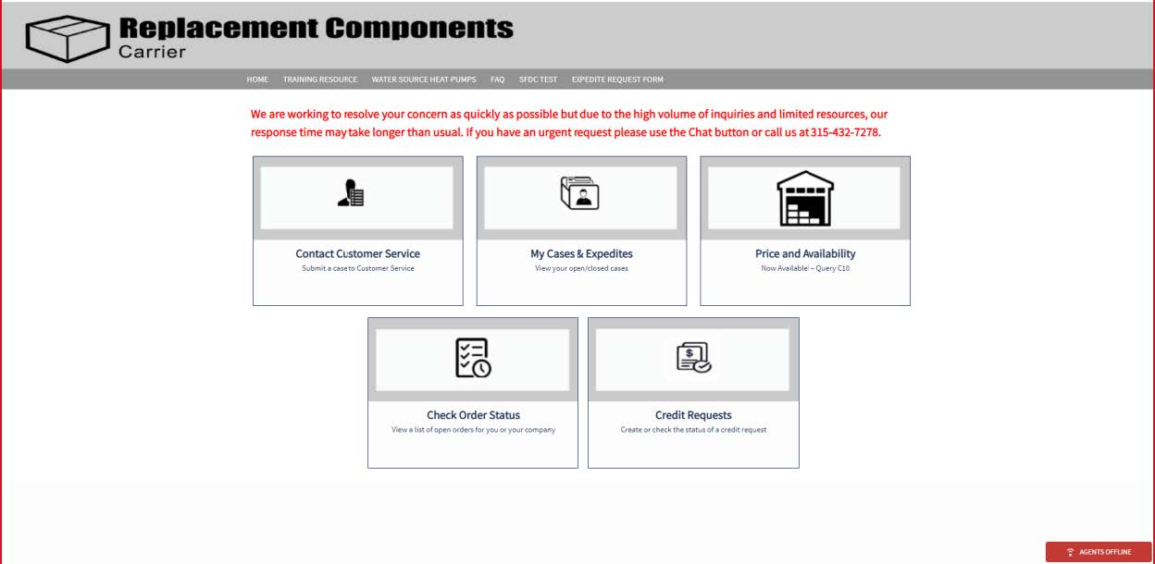
How to Navigate to Case Attachments and Status
Step 1: On the RC landing page, click on “My Cases and Expedites”

Slide 16
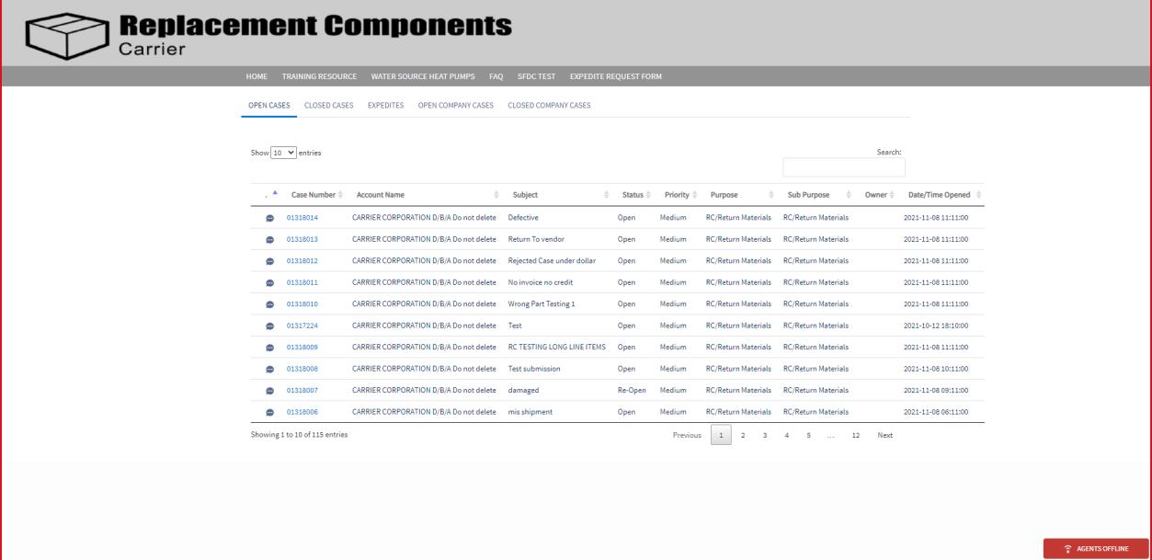
Step 2: Click on the case number to view the attachments

Slide 17
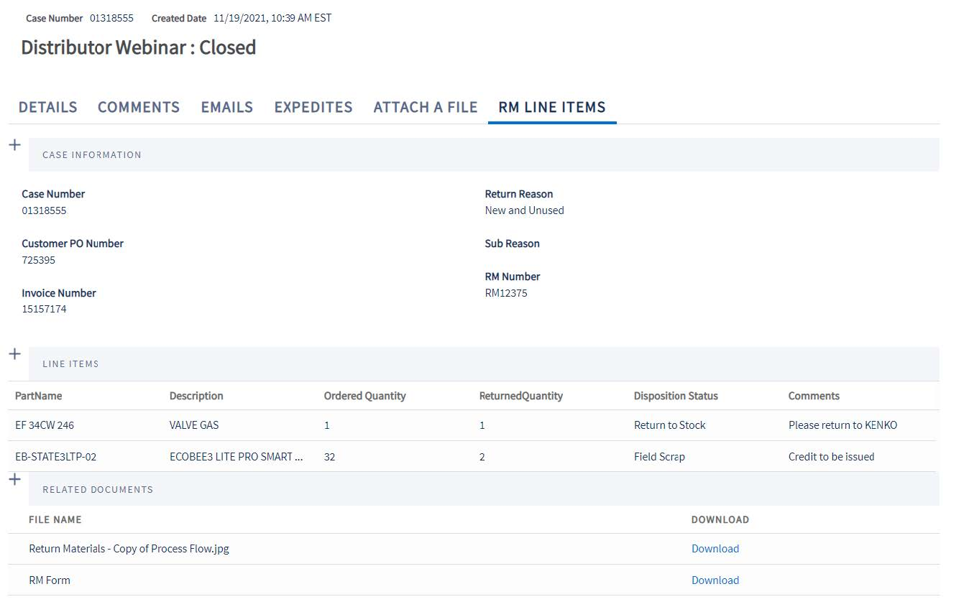
Step 3: Select RM Line Items section, you will find the RM Number, line-item disposition status, and the RMA Form/ FSO to download.

Slide 18
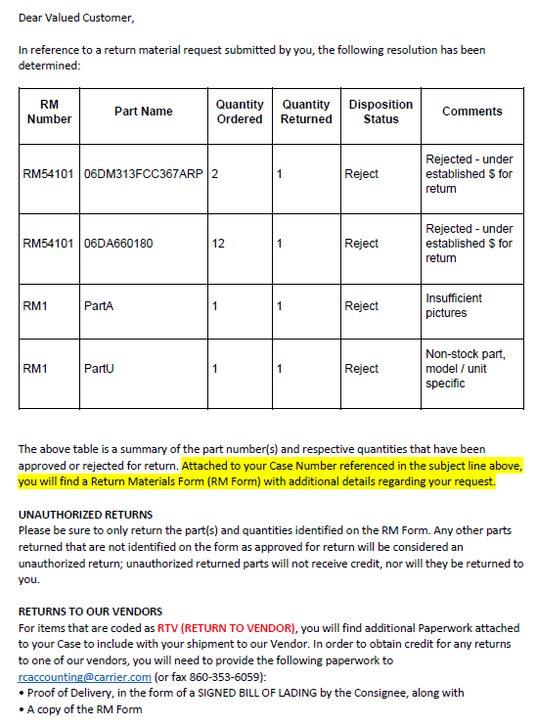
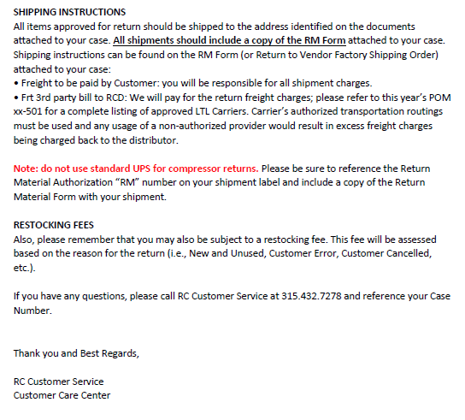
The below email will be sent to the customers once the disposition has been completed **This is an auto-generated email, do not reply as the mailbox is unmonitored**

Slide 19
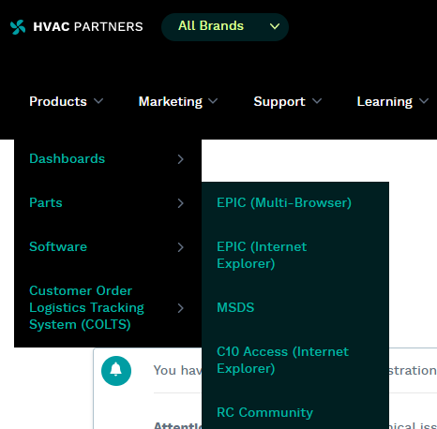
How to Look up Your Invoice Number using RC Community
Step 1: Log into HVACPartners, Select Products, Parts, RC Community

Slide 20
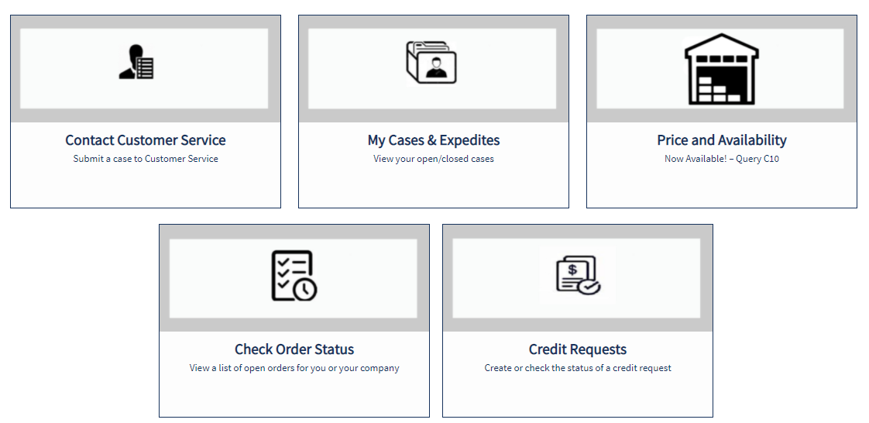
Step 2: Clicking on the Check Order Status tile from the RC Community Home Page allows customers to view information regarding their orders and company orders. You CANNOT make changes to the C10 order from within RC Community.

Slide 21
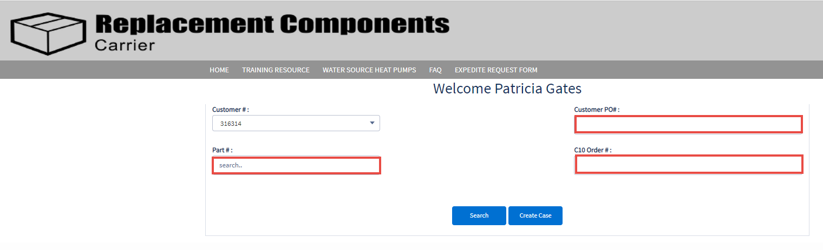
Step 3: You will notice your Customer # pulls into the Order Status page in the top left. If the customer # is incorrect, contact your HVACPartners Administrator. You must populate one of the other fields in order to obtain order information.

Slide 22
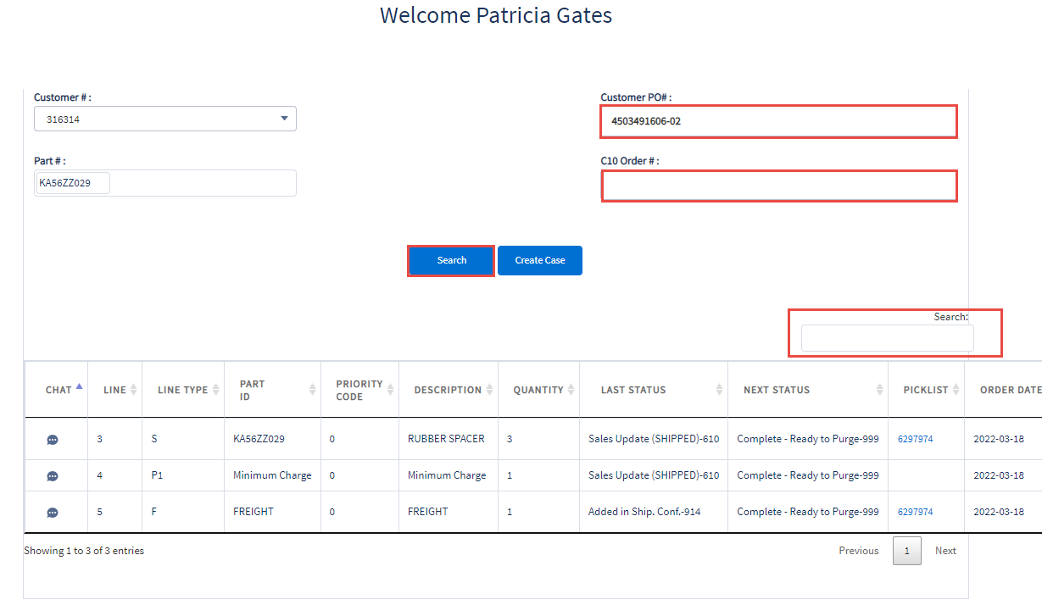
Step 4: If you would like to search by Customer PO# or C10 Order #, enter the number in the appropriate field and click Search button. A list of all the line items on that PO or C10 order will appear. To further refine the search results, use the Search box above the list of line items.

Slide 23
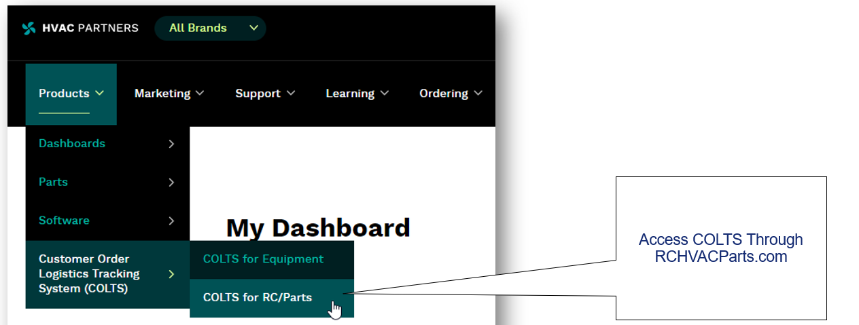
How to Look up Your Invoice Number using COLTS
Step 1: Log into HVACPartners, Select Products, Customer Order Logistics Tracking System (COLTS), COLTS for RC/Parts

Slide 24
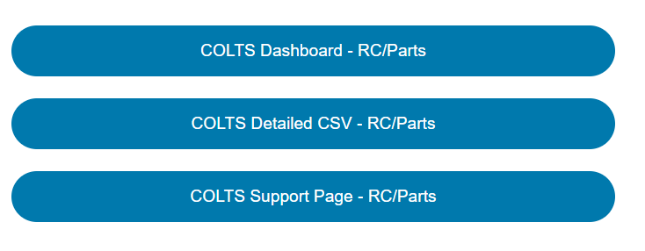
Step 2: Select COLTS Dashboard – RC/Parts

Slide 25
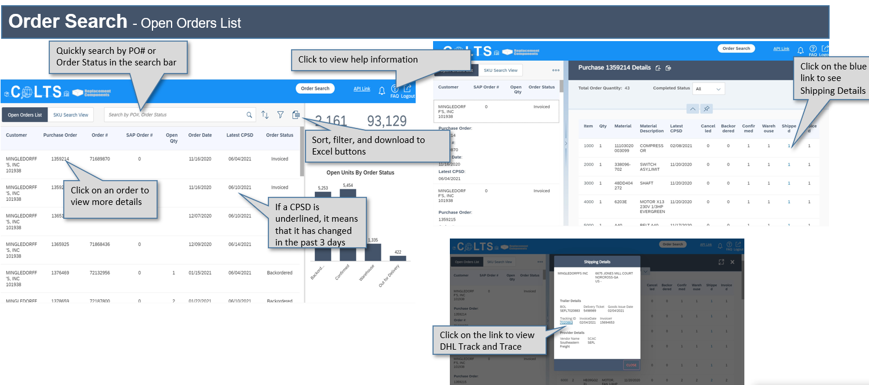
Step 3: Quickly search by PO# in the Search bar to drill down and view order details including invoice number.

Slide 26
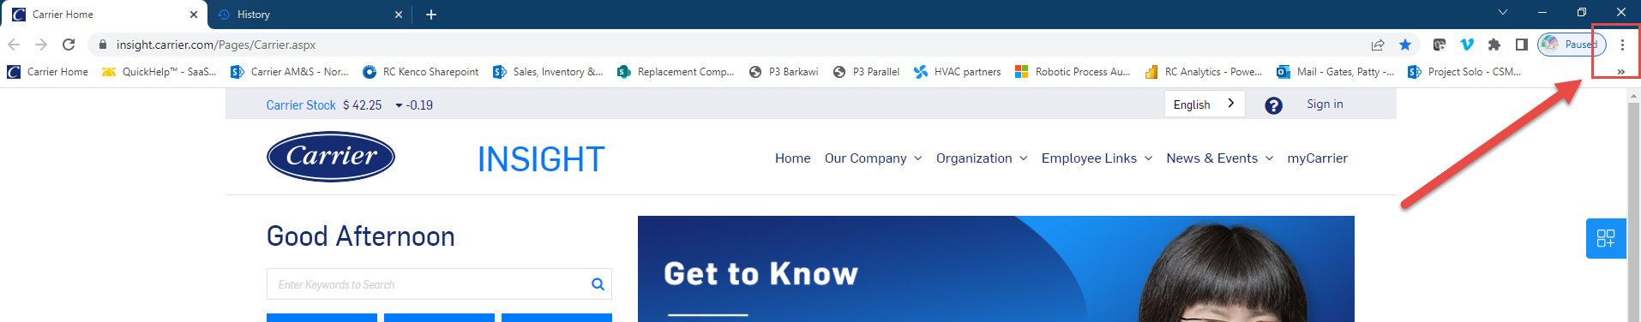
How to Clear your Browser Cache
Step 1: Open your internet browser and click on the 3 dots on the far right.

Slide 27
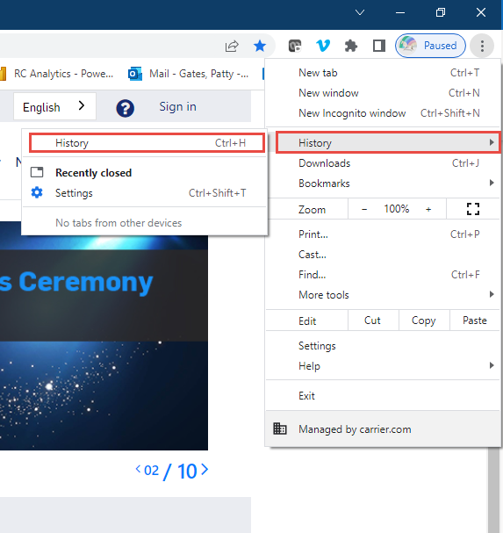
Step 2: Go to the history section

Slide 28
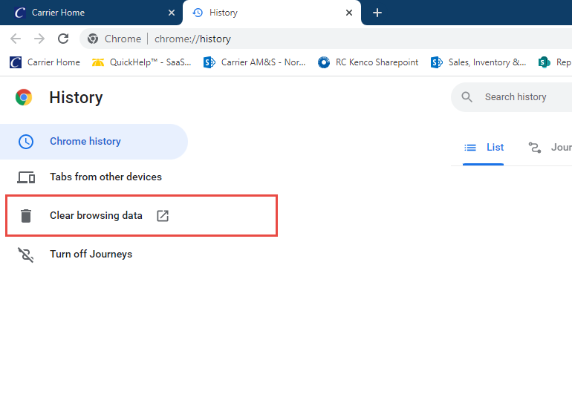
Step 2: Clear browsing data

Slide 29
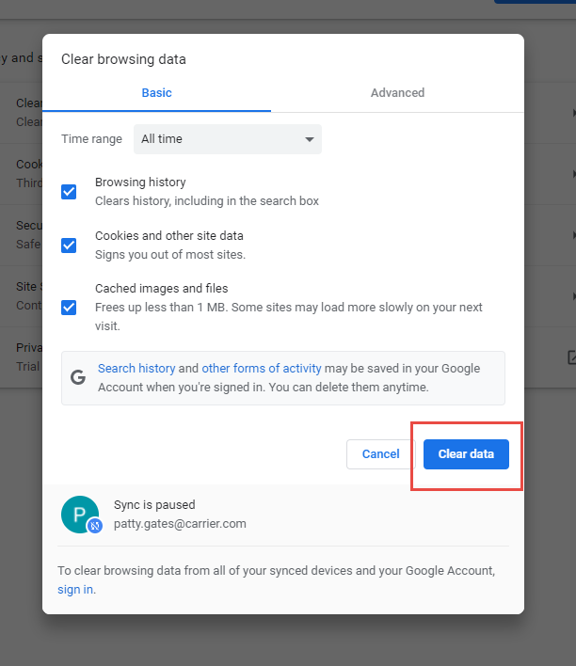
Step 3: Clear data

Slide 30

For further questions please Contact
RC RM COordinator
Or Enter a RM/Credit issue
Customer service Case IN RC Community

